Slide 1
Pune City Business Opportunities
An Analysis

Slide 2
Business opportunities in an upcoming city
Pune has been ranked as the eighth most populous city in India
estimated population of about 7.2 million as of 2019
Pune forms the urban core of the eponymous Pune Metropolitan Region (PMR).
Pune is also known as the "Oxford of the East" due to the presence of several well-known educational institutions
Research institutes of information technology, education, management and training attract students and professionals from India and overseas
How is the entire city structured with regard to infrastructure, strategic locations, population?
Which are the highly dense & well-developed areas that can be picked up for consideration
Which are the areas in Pune that provide the highest business opportunities? And for what kind of business.
Pune has emerged as a major educational hub in recent decades, with nearly half of the total international students in the country studying in Pune.

Slide 3
Data acquisition & cleaning
Multiple sources were leveraged:
Opendatasoft API (https://public.opendatasoft.com/explore/?sort=modified&q=pune), Pune city data, along with neighbourhoods was retrieved. Following features were available to form the city map.
Foursquare’s explore API (https://api.foursquare.com/v2/venues) (which gives venues recommendations) was leveraged. With Pune as the center, and a radius of 500 m to scout around
The dataset came with a set of 791 rows and 13 features spanning out across all locations within Maharashtra (depicted below).
An initial scan of missing values carried out, and the base data was cleaned up.
The next strep involved eliminating the unwanted features and renaming columns to meaningful names
Final dataset contained 110 rows with 9 features

Slide 4
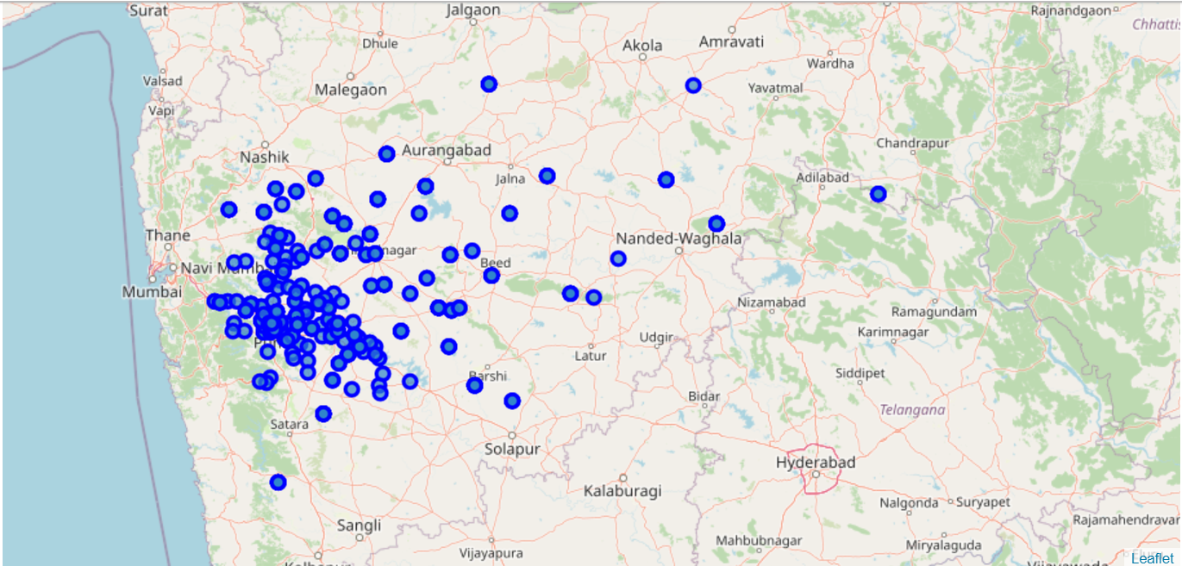
Filtering the dataset to significant areas around the city

Slide 5
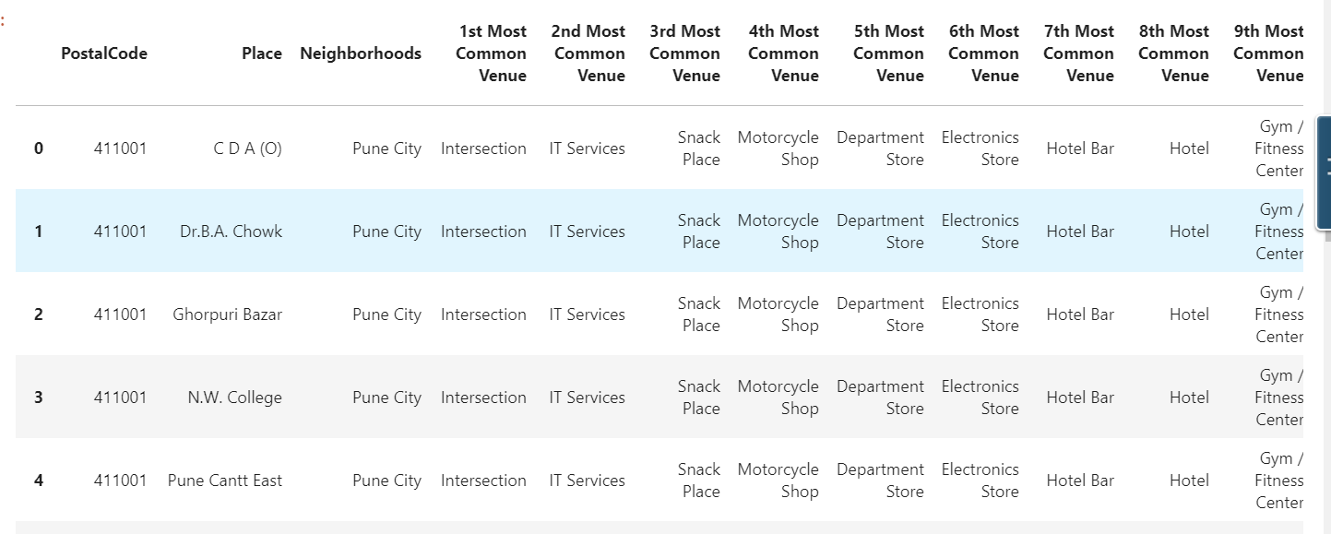
Categorizing the dataset to derive a deeper look into businesses

Slide 6
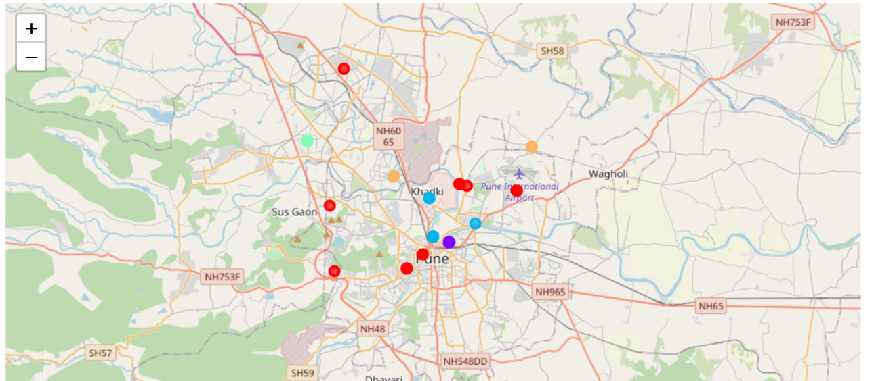
Clustering datapoints and reviewing on a map

Slide 7
Conclusion & Future directions
Based on location & clustering by venue/category – we have clustered our 110 locations into 5 different clusters. Each cluster is found to have it’s own significance based on the businesses corresponding popularity.
Pune Clusters
Indian Restaurants, Coffee Shoppes, Fast Food joints and Ice-cream shops
Mobile Phone shops, Vegetarian Restaurants, Electronics shops
Departmental Stores, Cinema Theaters, Hotel Bars and Gymnasiums
Restaurants, Hotels, Outlet Malls, Soccer fields and Gymnasiums.
Indian Restaurants, Snack places & Shopping Malls
A sizeable chunk of the business in Pune city is controlled by the Food & Beverages industry. Nearly 60% of all the businesses deal with cuisine of various kinds
An obvious and foregone conclusion towards Food & Beverage as a successful industry based on underlying datapoints and subsequent analysis is most certain.

Slide 8


Thanks!
This Photo by Unknown Author is licensed under CC BY-SA

